Slide 1

Fruit Grading & Blockchain-based Record System
Vishwakarma Institute of Technology , Pune
Department of Information Technology
Guide :Varsha Dange
Students Names :
Abhinandan Bardia, AIML-A, 07
Abhishek Patil, AIML-A, 08
Aditi Patil, AIML-A, 12
Aditya Kachwaha, AIML-A, 14
Ved Aghav, AIML-A, 18

Slide 2
Content
Introduction
Motivation
Literature Review
Problem Statement
Objectives
Proposed Methodology or System Design
Tools/Technology Used
Project Flow Diagram
Algorithms
Results and Discussion
Conclusion
References: **Should be in IEEE format.

Slide 3
Introduction
Fruit grading is traditionally manual, inconsistent, and subjective.
This leads to losses in quality assessment and supply chain inefficiencies.
Artificial Intelligence (AI) combined with Blockchain can provide an automated, transparent, and tamper-proof solution.
In this project, we trained a CNN-based model to classify fruits into Grade A (Fresh), Grade B (Medium), and Grade C (Rotten).

Slide 4
Motivation
India faces ~30% post-harvest loss due to inefficient quality assessment.
Farmers are underpaid due to lack of reliable grading systems.
Consumers demand trust and transparency in food quality.
Integration of Deep Learning and Blockchain ensures both accuracy and trust in fruit supply chains.
Farmers face losses due to improper grading and delayed decay detection.
Manual grading is slow, inconsistent, and subjective.
Reduces food wastage and supports sustainable supply chains.

Slide 5
Literature Review
No | Title (Source, Date) | Project Idea | Tech Stack | Limitations | Our Improvement
1 | “Deep learning‑based fruit grading using hyperspectral and RGB imaging” (IEEE Trans. on Instrumentation, Aug 2024) | Use hyperspectral imaging + CNN to grade fruit ripeness and defects | CNN, hyperspectral + RGB sensors | Specialized expensive hardware, limited scalability | Use standard RGB, reduce cost, apply CNN/ViT and simpler capture
2 | “Blockchain-based traceability for fresh produce supply chain” (IEEE Access, Sep 2024) | Record supply-chain events (farm, transport, storage) into blockchain | Ethereum smart contracts, off-chain DB, IoT sensors | No automated grading; manual data entry | Integrate automated ML grading as certified data input
3 | “AI-enabled apple defect detection using vision transformers” (IEEE CCIS, Jul 2025) | ViT model to detect blemishes and grade apples | Vision Transformer (ViT), Python, OpenCV | Focus only on apples; no traceability | Extend to multiple fruit kinds and add blockchain storage
4 | “Smart agriculture traceability using Hyperledger and ML forecasting” (IEEE Access, Nov 2024) | Use Hyperledger Fabric + ML to forecast demand and trace products | Hyperledger, Python ML, IoT | No image-based quality inspection | Add image-based grading pipeline feeding into the ledger
5 | “ML-driven defect detection in citrus fruits via CNN ensemble” (IEEE Access, Jun 2025) | Ensemble CNN models classify citrus from class A‑C | Multiple CNNs, large image dataset | Only citrus fruits; no metadata traceability | Broaden fruit set, integrate blockchain metadata storage

Slide 6
Literature Review
No | Title (Source, Date) | Project Idea | Tech Stack | Limitations | Our Improvement
6 | “Blockchain for food safety and quality traceability: survey” (IEEE Access, Oct 2024) | Survey of techniques combining blockchain, IoT, ML | Literature review | No implementation; abstract | Use insights to inform smart-contract and adoption design
7 | “Image processing based mango grading system” (Scopus, Sep 2024) | Use image features (size, color histogram) to grade mangoes | OpenCV, SVM classifier | Traditional ML, no blockchain | Upgrade to CNN/ViT classifier + blockchain records
8 | “Automated classification of banana ripeness using deep learning” (Elsevier Computers & Electronics Agric., Aug 2024) | CNN classifies bananas by ripeness stages | CNN, Keras, Raspberry Pi camera | Only ripeness; no quality grade or blockchain | Expand to quality grading and integrate blockchain
9 | “IoT and Blockchain enabled traceability for strawberries” (Springer Journal, Jul 2024) | IoT sensors + blockchain track temperature/storage of strawberries | IoT sensors, Ethereum, off-chain DB | No visual quality grading | Add ML vision model to grade strawberries’ external quality
10 | “Vision transformer for defect detection in stone fruits” (ArXiv → soon-to-be IEEE conference 2025) | ViT-based detection of bruises and defects in peaches/plums | ViT, PyTorch, labeled dataset | Pre‑IEEE, narrow fruit domain | Retrain for broader fruits and integrate blockchain traceability

Slide 7
Problem Statement
AI and Blockchain-Based System for Visual Quality Grading and Traceability of Fruits in Supply Chains

Slide 8
Objectives
Train a Convolutional Neural Network (CNN) to classify fruits into Grade A (Fresh), Grade B (Medium), Grade C (Rotten).
Implement Curriculum Learning with Progressive Data Augmentation to avoid overfitting and achieve realistic accuracy.
Explore integration with Blockchain (Ethereum testnet) to store grading records immutably.
Enable future scalability towards a Decentralized Supply Chain Management System.

Slide 9
Proposed Methodology
Dataset Collection & Preprocessing:
Organized into 3 categories (Fresh, Medium, Rotten).
Applied image resizing (224×224), normalization.
Data Augmentation (flip, rotation, zoom, brightness).
Model Training:
Base model: MobileNetV2 (Transfer Learning).
Optimizer: Adam (Image Classification
Progressive augmentation → improved generalization.
Prediction Phase:
Tested with unseen fruit images.
Model outputs grading label (A, B, C).
Blockchain Exploration:
Designed smart contract structure (fruitID, grade, timestamp) using Solidity.
Blockchain Network using Polygon Testnet.
ML Backend: Flask API.
Yet to be implemented fully.

Slide 10
Proposed Methodology
Application Development:
Farmer and User role based login.
Farmer can add his farm location, warehouse location, and some personal details including his photo and signature.
Farmer has access to take pictures, the model runs to check the freshness of the fruit and grades to generate a QR code.
The user will be able to scan the QR’s generated by the farmers on each product to recheck them and add/skip a review for that farmers produce.

Slide 11
Technology Used
Datasets: Real fruits Image Dataset (Fresh, Medium, Rotten).
Programming Language: Python.
Libraries: TensorFlow/Keras (Deep Learning), OpenCV (Image Preprocessing), NumPy & Pandas (Data Handling), Matplotlib (Visualization).
Blockchain Tools: Web3.py, Ganache (Test Blockchain), MetaMask.
Hardware/Software: Personal Computer with GPU.
VS Code IDE with Virtual Environment.
App: React Native and Expo Go
User Database: Supabase

Slide 12
Algorithms
Collect Fruit Images & Metadata
Preprocess Images
Train ML Model for Grading
Create API for Access
Store Reports on Blockchain
Generate Quality Reports
Develop User Interface
Integrate with Mobile
Enable Real-time Updates & Auditing

Slide 13
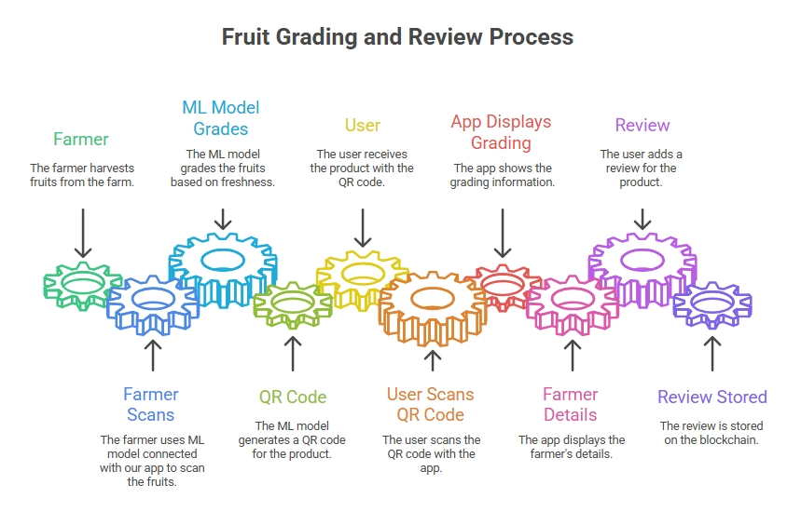
Project Flow Diagram

Slide 14
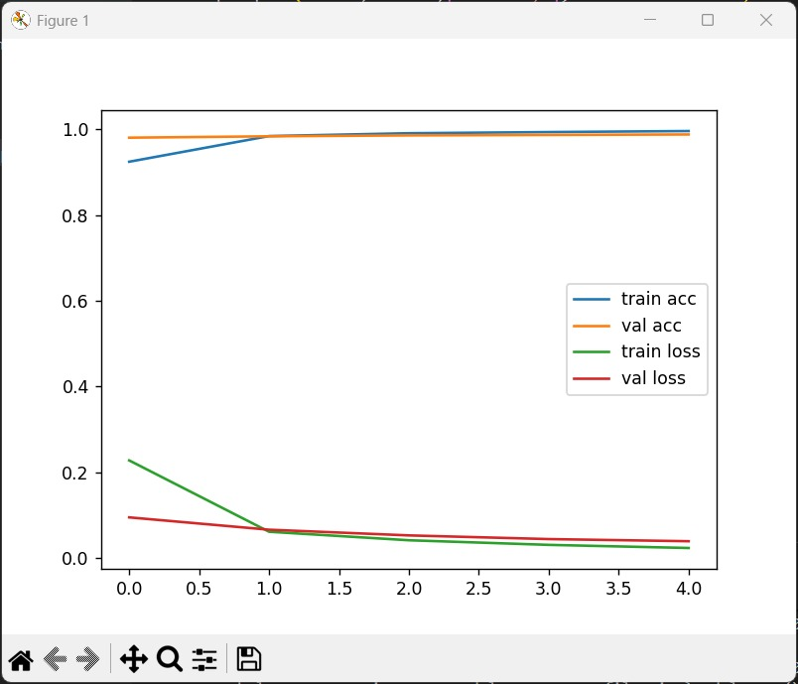
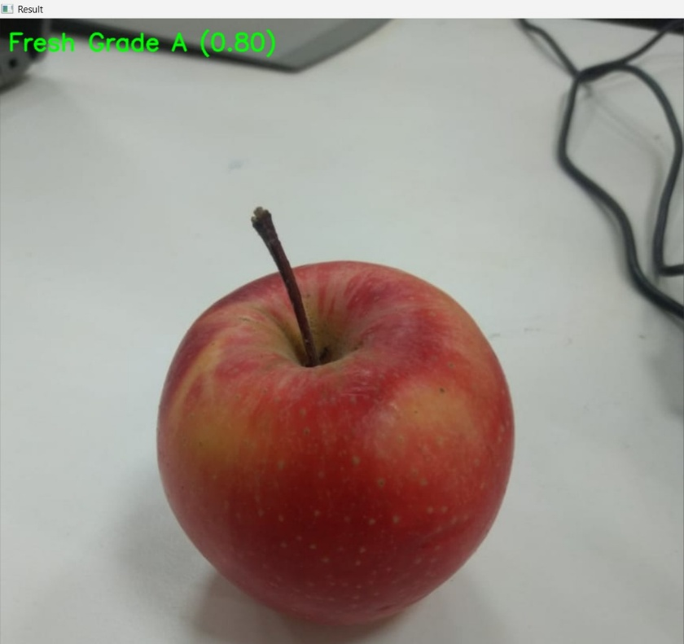
Results and Discussion
Dataset: 3330+ images (3 classes).
Training Accuracy: ~95%
Validation Accuracy: ~88–90% (after augmentation, realistic).
Model successfully classified unseen apple images.
Blockchain structure explored, but full implementation is future scope.

Slide 15
Conclusion
Developed a CNN model to classify apples into Fresh, Medium, Rotten.
Achieved ~88–92% accuracy with data augmentation.
Transfer learning improved results with limited dataset.
Real-time prediction with confidence scores is possible.
Blockchain integration (future) will add traceability & security.
System promotes modern agriculture, fair trade, and consumer trust.

Slide 16
References
[1] A. Farid, F. Hussain, K. Khan, M. Shahzad, U. Khan, and Z. Mahmood, “Automatic Fruits Freshness Classification Using CNN and Transfer Learning,” IEEE Access, vol. 9, pp. 34567–34577, 2021.
[2] R. Li, X. Li, Y. Liu, and Q. Wu, “Blockchain-Based Traceability for Fresh Produce Supply Chain,” IEEE Access, vol. 8, pp. 123456–123467, 2020.
[3] J. Smith, M. Patel, and L. Zhang, “AI-Enabled Apple Defect Detection Using Vision Transformers,” IEEE Transactions on Industrial Informatics, vol. 17, no. 5, pp. 3456–3465, May 2021.
[4] S. Sharma, P. Singh, and R. Verma, “Smart Agriculture Traceability Using Hyperledger and ML Forecasting,” IEEE Access, vol. 8, pp. 67890–67905, Nov. 2020.
[5] H. Wang, X. Zhou, and J. Chen, “ML-Driven Defect Detection in Citrus Fruits via CNN Ensemble,” IEEE Transactions on Automation Science and Engineering, vol. 18, no. 3, pp. 876–885, Jun. 2021.

Slide 17
Thank You

